Slide 1


Kubernetes Training

Slide 2
Day 2: Cluster Administration Operations
The concept of packaging: Helm
Jsonnet & Kubecfg
Lunch break
Creating users
RBAC
Limits and Quotas
NetworkPolicies

Slide 3
I - The concept of packaging: Helm

Slide 4
Questions
In the activity suggested on last session, what resources have we created so far?
What do they all have in common?
Type: Deployment name: wordpress
Type: Deployment name: mysql
What if I want to deploy another WordPress + MariaDB?
Type: Service name: wordpress
Type: Service name: mysql
and 30 more? with small modifications?
Type: ConfigMap name: wordpress
Type: PVC name: mariadb-pvc
Can we have a reusable and maintainable approach?
Type: Secret name: wp-secret
Type: Secret name: mariadb-secret
“Package” WordPress??

Slide 5




Kubernetes Packaging
Need a tool to manage a group of resources as a single unit

Slide 6


Helm
Developed by Deis. Bitnami is a main collaborator
Kubernetes package: Chart
Chart catalog available. Known as the “apt-get” of Kubernetes.
Type: Deployment
Type: Deployment
Type: Service
Type: Service
Type: PVC
Type: PVC
Type: Ingress
Type: Secret
Chart WordPress

Slide 7
Getting started with Helm (I)
Download helm binaries from their release page.
# macOS example wget https://storage.googleapis.com/kubernetes-helm/helm-v2.10.0-darwin-amd64.tar.gz tar xfv helm-v2.9.0-darwin-amd64.tar.gz sudo mv darwin-amd64/helm /usr/local/bin
Let’s play
# Initialize helm helm init # Check part of the available catalog helm search stable # Deploy a chart in the cluster helm install stable/dokuwiki # List releases in the cluster helm list
Note: Charts deployments are called releases

Slide 8
Getting started with Helm (II)
You can create the skeleton of a Helm Chart using the command below:
# Create a new chart helm create my-nginx
|____my-nginx | |____Chart.yaml | |____charts | |____.helmignore | |____templates/ | | |____deployment.yaml | | |____NOTES.txt | | |____ingress.yaml | | |____service.yaml | | |_____helpers.tpl | |____values.yaml
We already have the yaml files from our WordPress + MariaDB, can we create a chart? Let’s try!
Let’s try deploying the chart
# Install the chart helm install my-wordpress/

Slide 9
Are we done with Helm?
Need a tool to manage a group of resources as a single unit
What if I want to deploy another WordPress + MariaDB?
X
# Deploy another release chart helm install my-wordpress Error: release geared-puma failed: configmaps "wordpress-config" already exists

Slide 10
Templating our resources
Resources in a helm chart are written using template language
kind: Deployment metadata: name: frontend-wp spec: replicas: 1 template: spec: containers: - name: wp image: bitnami/wordpress volumeMounts: - mountPath: /bitnami name: wpvol env: - name: WORDPRESS_BLOG_NAME value: "My blog" volumes: - name: wpvol persistentVolumeClaim: claimName: wppvclaim
kind: Deployment metadata: name: {{ template "fullname" . }} spec: replicas: {{ .Values.replicaCount }} template: spec: containers: - name: wp image: {{ .Values.image }} volumeMounts: - mountPath: /bitnami name: wpvol env: - name: WORDPRESS_BLOG_NAME value: {{ .Values.app.blogName }} volumes: - name: wpvol persistentVolumeClaim: claimName: {{ template "fullname" . }}-pvc
Engine: Go template
Parametrized deployments

Slide 11
What data can I use in my templates? (I)
Several objects available
Chart: metadata about the chart. Stored in chart.yaml
|____my-wordpress | |____Chart.yaml | |____charts | |____.helmignore | |____templates/ | | |____deployment.yaml | | |____NOTES.txt | | |____ingress.yaml | | |____service.yaml | | |_____helpers.tpl | |____values.yaml
apiVersion: v1 appVersion: "1.0" description: A Helm chart for Kubernetes name: myWordpress version: 0.1.0
Release: runtime information about the deployment of the chart (Release). Examples:
Release.Name: The release name (random unless specified otherwise)
Release.Time: The time of the release

Slide 12
What data can I use in my templates? (II)
Several objects available
Values: Values passed into the template from the values.yaml file and from user-supplied files.
|____my-wordpress | |____Chart.yaml | |____charts | |____.helmignore | |____templates/ | | |____deployment.yaml | | |____NOTES.txt | | |____ingress.yaml | | |____service.yaml | | |_____helpers.tpl | |____values.yaml
replicaCount: 1 image: bitnami/wordpress:4.9.4-r5 app: blogname: "Default name" # ...
Contains default values that can be changed:
helm install myWordpress --set app.blogname=”This is my blog”
Other objects: Capabilities, Files, Template

Slide 13
Go template language
A template directive is enclosed in {{ and }} blocks
|____my-wordpress | |____Chart.yaml | |____charts | |____.helmignore | |____templates/ | | |____deployment.yaml | | |____NOTES.txt | | |____ingress.yaml | | |____service.yaml | | |_____helpers.tpl | |____values.yaml
Inside a template directive you can:
Access an object’s value using .
chart: "{{ .Chart.Name }}-{{ .Chart.Version }}"
replicas: {{ .Values.replicaCount }}

Slide 14
Go template language
Inside a template directive you can:
Call a Go template function¹
{{ quote .Chart.Name }}
{{ default "" .Values.app.email }}
{{ printf "%s-%s" .Release.Name "externaldb" }}
{{ upper ".Values.app.blogName }}
1 https://godoc.org/text/template
https://godoc.org/github.com/Masterminds/sprig

Slide 15
Go template language
Inside a template directive you can:
Combine values and functions¹ in pipelines (Unix-like)
{{ .Values.wordpressUsername | quote }}
{{ default "" .Values.app.username | quote }}
{{ toYaml .Values.app.settings | indent 8 }}
{{ printf "%s-%s" .Chart.Name .Chart.Version | replace "+" "_" | trunc 63 }}
1 https://godoc.org/text/template
https://godoc.org/github.com/Masterminds/sprig

Slide 16
Go template language
|____myWordpress | |____Chart.yaml | |____charts | |____.helmignore | |____templates/ | | |____deployment.yaml | | |____NOTES.txt | | |____ingress.yaml | | |____service.yaml | | |_____helpers.tpl | |____values.yaml
Inside a template directive you can:
Re-use a previously defined template macro
{{ template "mywordpress.fullname" . }}
{{ template "mywordpress.name" . }}
{{/* Expand the name of the chart. */}} {{- define "mywordpress.name" -}} {{- default .Chart.Name .Values.nameOverride | trunc 63 | trimSuffix "-" -}} {{- end -}}

Slide 17
Go template language
Inside a template directive you can:
Use control structures
if-else
{{- if .Values.mariadb.enabled }} value: {{ .Values.mariadb.mariadbUser | quote }} {{- else }} value: {{ .Values.externalDatabase.user | quote }} {{- end }}
foreach
users: |- {{- range .Values.users }} - {{ . | title | quote }} {{- end }}

Slide 18

How charts are deployed
A server called tiller is in charge of rendering and deploying charts
helm install my-wordpress/
Your cluster
kind: Deployment metadata: name: {{ template "fullname" . }} spec: replicas: {{ .Values.replicaCount }} template: spec: containers: - name: wp image: {{ .Values.image }} ...
kind: Deployment metadata: name: pilfering-anaconda spec: replicas: 1 template: spec: containers: - name: wp image: bitnami/wordpress:4.8.3 ...
Tiller

Slide 19
Hands on!
Demo 2
Edit your WordPress chart using some template functions
Deploy WordPress modifying some settings from the command line

Slide 20
Reusing other charts
Dependencies will be stored here
Charts can use already existing charts
|____myWordpress | |____Chart.yaml | |____charts/ | |____.helmignore | |____templates/ | | |____deployment.yaml | | |____NOTES.txt | | |____ingress.yaml | | |____service.yaml | | |_____helpers.tpl | |____requirements.yaml | |____values.yaml
dependencies: - name: mariadb version: 2.1.1 repository: https://charts.storage.googleapis.com/ condition: mariadb.enabled
# myWordpress Values.yml image: bitnami/wordpress:4.6.3 ... ## MariaDB chart configuration mariadb: enabled: true mariadbDatabase: bitnami_wordpress # mariadbRootPassword:
Values.yaml will redefine some values of the original chart

Slide 21
Upgrading charts
Existing releases can be rolling-updated
helm upgrade my-stable-wordpress stable/wordpress --set ingress.enabled=true helm upgrade my-stable-wordpress stable/wordpress --set image.tag=4.8.9
There is a history of the whole release
helm history my-stable-wordpress REVISION UPDATED STATUS CHART DESCRIPTION 1 Mar 15 17:13:06 2018 SUPERSEDED stable/wordpress Install complete 2 Mar 15 17:13:46 2018 DEPLOYED stable/wordpress Upgrade complete
Rolling back is possible
helm rollback my-stable-wordpress 1

Slide 22
Working with chart repositories
A chart repository is a location where packaged charts can be stored and shared. It is an HTTP server that serves an index.yaml and packaged charts.
List chart repositories
helm repo list
Add chart repository
helm repo add bitnami https://charts.bitnami.com/bitnami
Update chart repository
helm repo update

Slide 23
II - Jsonnet & Kubecfg

Slide 24
Question
... - name: MARIADB_HOST {{- if .Values.mariadb.enabled }} value: {{ template "mariadb.fullname" . }} {{- else }} value: {{ .Values.externalDatabase.host | quote }} {{- end }} - name: MARIADB_PORT_NUMBER {{- if .Values.mariadb.enabled }} value: "3306" {{- else }} value: {{ .Values.externalDatabase.port | quote }} {{- end }} - name: WORDPRESS_DATABASE_NAME {{- if .Values.mariadb.enabled }} value: {{ .Values.mariadb.mariadbDatabase | quote }} {{- else }}
What if I want to use another variable not defined in the chart?
Solution → Change the templates so it accepts it
Rigid, we can end up having a very complex chart or multiple variations

Slide 25
Another approach: Jsonnet
Language from Google that helps you define JSON data
Includes operations like variable declarations, import, substitution, addition, substraction, concatencation...
Compatible with pure JSON content
Project page: https://github.com/google/jsonnet/

Slide 26
Where Jsonnet really excels (really simple example)
{ "apiVersion": "apps/v1beta1", "kind": "Deployment", "metadata": { "name": "frontend-wp" }, "spec": { "replicas": 1, "template": { "spec": { "containers": [ { "name": "wp", "image": "bitnami/wordpress", "env": [ { "name": "WORDPRESS_DATABASE_NAME", "value": "bitnami_wordpress" }, { "name": "ALLOW_EMPTY_PASSWORD", "value": "yes" } ] } ] } }
I want a modified version of this JSON
{ "apiVersion": "apps/v1beta1", "kind": "Deployment", "metadata": { "name": "frontend-wp" }, "spec": { "replicas": 2, "template": { "spec": { "containers": [ { "name": "wp", "image": "bitnami/wordpress", "env": [ { "name": "WORDPRESS_DATABASE_NAME", "value": "bitnami_wordpress" }, { "name": "ALLOW_EMPTY_PASSWORD", "value": "yes" } ] } ] } }
wp-dep.json
local wp = import "wp-dev.json"; wp { "spec"+: { "replicas": 2 } }
Replace replica value
new-frontend.jsonnet
Execute jsonnet command to render
jsonnet new-frontend.jsonnet

Slide 27
Where Jsonnet really excels (the case of the initial question)
{ "apiVersion": "apps/v1beta1", "kind": "Deployment", "metadata": { "name": "frontend-wp" }, "spec": { "replicas": 1, "template": { "spec": { "containers": [ { "name": "wp", "image": "bitnami/wordpress", "env": [ { "name": "WORDPRESS_DATABASE_NAME", "value": "bitnami_wordpress" }, { "name": "ALLOW_EMPTY_PASSWORD", "value": "yes" } ] } ] } }
I want a modified version of this JSON
{ "apiVersion": "apps/v1beta1", "kind": "Deployment", "metadata": { "name": "frontend-wp" }, "spec": { "replicas": 1, "template": { "spec": { "containers": [ { "name": "wp", "image": "bitnami/wordpress", "env": [ { "name": "WORDPRESS_DATABASE_NAME", "value": "bitnami_wordpress" }, { "name": "ALLOW_EMPTY_PASSWORD", "value": "yes" }, { "name": "WORDPRESS_BLOG_NAME", "value": "My Blog" } ...
wp-dep.json
local wp = import "wp-dev.json"; local cont = wp.spec.template.spec.containers[0]; wp { "spec"+: { "template"+: { "spec"+: { "containers": [ cont { "env"+: [ { "name": "WORDPRESS_BLOG_NAME", "value": "My blog" } ] } ] } } } }
wp-dep2.jsonnet

Slide 28
Benefits
Very flexible language
1 big template → different files with little modifications
Several functions available for more complex operations
There are libraries with the most common K8s objects

Slide 29
Kubecfg
Built for declarative, “gitops” workflow.
JSON, YAML, jsonnet input
Whole config in one invocation, not separate fragments
Optimised for automated pipelines, rather than interactive use
Simple client-side tool
Obeys RBAC. No need for an “admin” uber-job in-cluster
Github: https://github.com/anguslees/kubecfg

Slide 30
Kubecfg (ii)
kubecfg expands jsonnet, and walks down the result looking for k8s objects
Expands arrays → items
Expands objects → values
Expands k8s v1.List → items
Adds ability to import by URL, not just file paths
Main subcommands:
kubecfg validate - Read-only. Run from tests/CI.
kubecfg update - Push configs to cluster. Run from release branch/CD.

Slide 31

III - Creating users

Slide 32



Up until now...
We’ve been accessing the cluster with admin credentials
In a real cluster we may want to have different users, groups and privileges
user: jsalmeron
group: dev, tech-lead
user: jjo
group: sre, tech-lead
Developer
Administrator
user: juan
group: dev
user: dbarranco
group: sre, devops
Developer
Administrator
If in Kubernetes everything is modelled as an API Object, maybe there’s something like
kubectl create user ...

Slide 33
User management in Kubernetes
Kubernetes provides no API objects for users*
User management must be configured by the cluster administrator. Examples:
Certificate-based authentication
Token-based authentication
Basic authentication
OAuth2
*At least something like we have for Deployments, Pods… etc.

Slide 34


Certificate-based authentication
Kubernetes is configured with a Certificate Authority (CA)
/etc/kubernetes/pki/ca.crt
/etc/kubernetes/pki/ca.key
Public certificate
Private key
Every SSL certificate signed with this CA will be accepted by the Kubernetes API
Possible options for creating certificates: OpenSSL or CloudFlare's PKI toolkit
Two important fields in the SSL certificate:
Common Name (CN): Kubernetes will interpret this value as the user
Organization (O): Kubernetes will interpret this value as the group

Slide 35
Creating user certificate: steps
Create private key (if it does not exist)
openssl genrsa -out juan.key 2048
Create certificate signing request (CSR)
Developer
openssl req -new -key juan.key -out juan.csr -subj "/CN=juan/O=devs"
user
group
Send the CSR to the administrator
Create certificate from CSR using the cluster authority
Administrator
openssl x509 -req -in juan.csr -CA CA_LOCATION/ca.crt -CAkey CA_LOCATION/ca.key -CAcreateserial -out juan.crt -days 500

Slide 36
Next step: Create kubectl configuration
To add in your local machine the new configuration:
Download the cluster authority and generated certificate
Add the new cluster to kubectl
kubectl config set-cluster sandbox --certificate-authority=ca.pem --embed-certs=true --server=https://<PUBLIC_ADDRESS_OF_YOUR_CLUSTER>:6443
Add the new credentials to kubectl
kubectl config set-credentials juan --client-certificate=juan.crt --client-key=juan.key --embed-certs=true
Add the new context to kubectl
kubectl config set-context sandbox-juan --cluster=sandbox --user=juan

Slide 37
Finally: Test your new configuration
Change to the newly created context
kubectl config use-context sandbox-juan
You can have multiple clusters and configurations
Let’s execute a basic command
kubectl get pods
What happened?
Error from server (Forbidden): pods is forbidden: User "juan" cannot list pods in the namespace "default"

Slide 38

IV - Role Based Access Control (RBAC)

Slide 39


RBAC in Kubernetes
Three important groups
ConfigMaps
Pod
Service
AutoScaler
list
get
Developer
Developer
Deployment
Secrets
create
watch
PV
ReplicaSets
Ingress
Administrator
Administrator
delete
patch
Namespace
DaemonSet
Job
Nodes
OS Process
CronJob
Process in Pod
PVC
Subjects
API Resources
Operations (Verbs)
RBAC connects the three of them

Slide 40
RBAC in Kubernetes: Roles
Establish a set of allowed operations (rules) over a set of resources in a namespace
ConfigMaps
role pod-access
Pod
list
get
Service
AutoScaler
create
delete
Secrets
Deployment
role ns-admin
patch
watch
ReplicaSets
Ingress
Job
DaemonSet
CronJob
Namespaced API Resources
Operations
namespace “test”

Slide 41
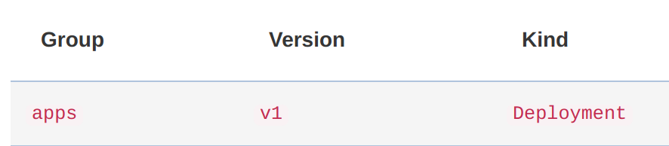
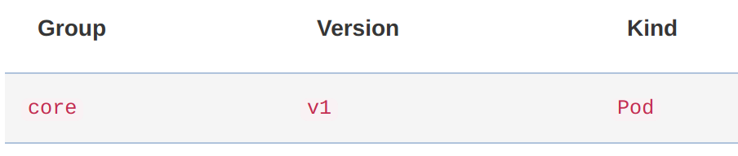
RBAC in Kubernetes: Roles
Need to specify:
Api group
Name
Find it in the API reference, examples
kind: Role apiVersion: rbac.authorization.k8s.io/v1beta1 metadata: namespace: test name: pod-access rules:
- apiGroups: [""] resources: ["pods"]
WHICH RESOURCES
verbs: ["get", "list"]
WHICH OPERATIONS
When it is core, we use an empty string

Slide 42
RBAC in Kubernetes: Roles
kind: Role apiVersion: rbac.authorization.k8s.io/v1beta1 metadata: namespace: test name: ns-admin rules: - apiGroups: ["*"] resources: ["*"] verbs: ["*"]
Wildcards are allowed

Slide 43
RBAC in Kubernetes: RoleBindings
Connects a role to a subject or set of subjects
user: jsalmeron
group: tech-lead, dev
role pod-access
Developer
user: dgalvez
group: dev
Developer
role ns-access
user: juan
group: dev
Developer
namespace “test”

Slide 44
RBAC in Kubernetes: RoleBinding
Examples
User
Group
...
Later we will see another one
kind: RoleBinding apiVersion: rbac.authorization.k8s.io/v1 metadata: name: devs-read-pods namespace: test subjects: roleRef:
- kind: Group
name: devs
apiGroup: rbac.authorization.k8s.io
WHICH SUBJECTS
Used to specify which api group the kind belongs to
kind: Role
name: pod-access
apiGroup: rbac.authorization.k8s.io
WHICH ROLE (ONLY ONE PER BINDING)

Slide 45
RBAC in Kubernetes: RoleBinding
kind: RoleBinding apiVersion: rbac.authorization.k8s.io/v1 metadata: name: salme-ns-admin namespace: test subjects: - kind: User name: jsalmeron # Name is case sensitive apiGroup: rbac.authorization.k8s.io roleRef: kind: Role name: ns-admin apiGroup: rbac.authorization.k8s.io
Mini-exercise: Another way of doing this?

Slide 46
RBAC in Kubernetes: ClusterRoles
Establish a set of allowed operations over a set of resources in the whole cluster
ConfigMaps
role all-pods-access
Pod
list
get
Service
AutoScaler
PV
create
delete
Secrets
Deployment
role pv-admin
watch
patch
ReplicaSets
Ingress
Nodes
Job
DaemonSet
CronJob
PVC
All API Resources
Operations

Slide 47
RBAC in Kubernetes: ClusterRoles
Roles and ClusterRoles have very similar yaml
kind: Role apiVersion: rbac.authorization.k8s.io/v1beta1 metadata: name: pod-access namespace: test rules: - apiGroups: [""] resources: ["pods"] verbs: ["get", "list"]
kind: ClusterRole apiVersion: rbac.authorization.k8s.io/v1beta1 metadata: name: all-pod-access rules: - apiGroups: [""] resources: ["pods"] verbs: ["get", "list"]
Only difference

Slide 48
RBAC in Kubernetes: ClusterRoleBinding
Connects a role to a subject or set of subjects
user: jsalmeron
group: tech-lead, dev
role all-pod-access
Developer
user: dbarranco
group: sre, dev, devops
Administrator
role pv-admin
user: jbianquetti
group: sre, dev
Administrator
Whole cluster

Slide 49
RBAC in Kubernetes: ClusterRoleBinding
Just like the previous case, very similar YAML
kind: RoleBinding apiVersion: rbac.authorization.k8s.io/v1 metadata: name: devs-read-pods namespace: test subjects: - kind: User name: jsalmeron # Name is case sensitive apiGroup: rbac.authorization.k8s.io roleRef: kind: Role name: ns-admin apiGroup: rbac.authorization.k8s.io
kind: ClusterRoleBinding apiVersion: rbac.authorization.k8s.io/v1 metadata: name: salme-reads-all-pods subjects: - kind: User name: jsalmeron # Name is case sensitive apiGroup: rbac.authorization.k8s.io roleRef: kind: ClusterRole name: all-pod-access apiGroup: rbac.authorization.k8s.io
Only differences
Only differences

Slide 50
Default ClusterRoleBindings
Kubernetes includes some ClusterRoleBindings. For example:
system:basic-user: For unauthenticated users (group system:unauthenticated). No operations are allowed.
cluster-admin: For members of the system:masters group. Can do any operation on the cluster (using cluster-admin ClusterRole).
Admin accounts can be created belonging to this group
Administrator
openssl req ... -subj "/CN=dbarranco/O=system:masters"
ClusterRoleBindings for the different components of the cluster (kube-controller-manager, kube-scheduler, kube-proxy …)

Slide 51
More about the possible actions (verbs)
list
get
create
watch
TRIVIA: Example operations and their requirements
delete
patch
kubectl run --image=bitnami/mongodb my-mongodb
deployments: create
kubectl get deployments -w
deployments: get, list, watch
kubectl delete deployment my-mongodb
deployments: get, delete
kubectl edit deployment my-mongodb mypod
deployments: get, patch
kubectl expose deployment my-mongodb --port=27017 --type=NodePort
deployments: get
services: create
pods: get
kubectl exec -ti mypod bash
pods/exec: create

Slide 52
Questions
Find the necessary RBAC rules so the user can contact Helm’s Tiller pod
We know that this command should work with the previously created RBAC rules (salme-ns-admin)
helm install stable/wordpress --namespace test
And what about this command?
helm install stable/wordpress --namespace default
Regenerate the Tiller pod and try the command again
helm reset --force && helm init
Error: rpc error: code = Unknown desc = configmaps is forbidden: User "system:serviceaccount:kube-system:default" cannot list configmaps in the namespace "kube-system"

Slide 53


Flashback
A server called tiller is in charge of rendering and deploying charts
Your cluster
helm install my-wordpress/
kind: Deployment metadata: name: {{ template "fullname" . }} spec: replicas: {{ .Values.replicaCount }} template: spec: containers: - name: wp image: {{ .Values.image }} ...
kind: Deployment metadata: name: pilfering-anaconda spec: replicas: 1 template: spec: containers: - name: wp image: bitnami/wordpress:4.8.3 ...
Process in Pod
Tiller
Kubernetes API
How do we configure this? Do we need to provide a certificate to the pod?

Slide 54
RBAC in Kubernetes (again): ServiceAccount
Tiller
While regular users are not handled by Kubernetes, processes inside pods do have an API object
ServiceAccount
Developer
Administrator
OS Process
Process in Pod
Necessary for pods that need to contact Kubernetes API
Also used for other operations like storing image pull secrets

Slide 55
RBAC in Kubernetes (again): ServiceAccount
apiVersion: v1 kind: ServiceAccount metadata: name: my-service-account
An API token will be automatically created and stored in the cluster
Can be used in RoleBinding and ClusterRoleBinding as subjects
Examples
User
Group
...
Later we will see another one
ServiceAccounts are used in Pod/RS/Deployment declarations
apiVersion: v1 kind: Pod metadata: name: my-pod spec: serviceAccountName: my-service-account
The API token will be mounted inside the containers
If not specified it will use the “default” ServiceAccount

Slide 56

Deploying Tiller
Create a Tiller ServiceAccount
kind: ClusterRoleBinding apiVersion: rbac.authorization.k8s.io/v1 metadata: name: tiller-rolebinding subjects: - kind: ServiceAccount name: tiller-sa # Name is case sensitive apiGroup: rbac.authorization.k8s.io namespace: kube-system roleRef: kind: ClusterRole name: cluster-admin apiGroup: rbac.authorization.k8s.io
apiVersion: v1 kind: ServiceAccount metadata: name: tiller-sa namespace: kube-system
Set up RBAC for Tiller
Which operations requires Tiller?
In principle, it can deploy ANYTHING in ANY NAMESPACE

Slide 57
Deploying Tiller
Update the tiller pod
helm init --service-account tiller-sa --upgrade
Let’s check if Tiller works now
helm ls

Slide 58
V - Quotas and Limits

Slide 59
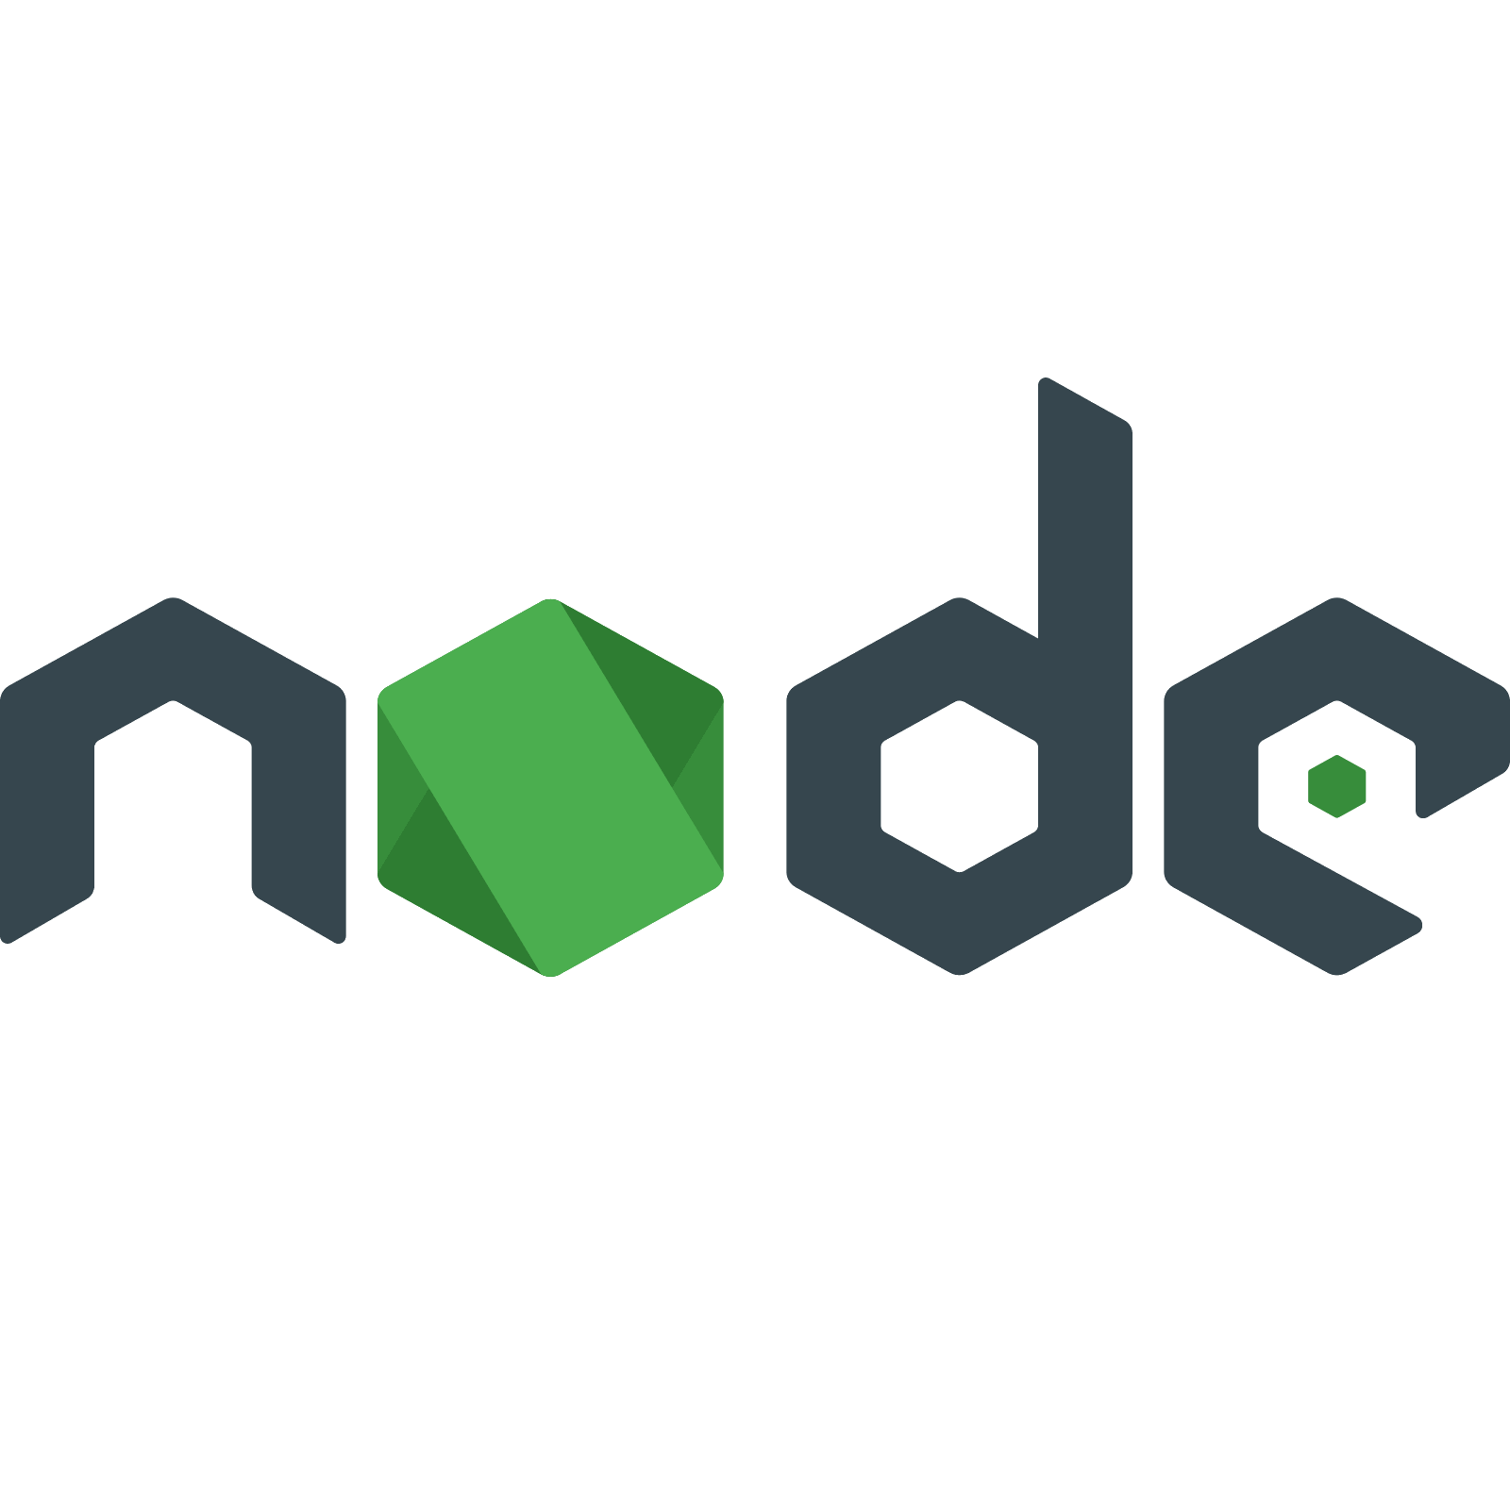

Needing quotas
Let’s imagine the following context
Cluster with 128 cores and 512 GB of RAM
Team vision: Computionally expensive tasks
Team api: lightweight microservices
We may want to:
namespace “team-vision”
namespace “team-api”
Provide just the amount of CPU and Memory the team requires
Make sure that no team will take all the resources in the cluster.
Developer
Developer
Max CPU: 100 cores
Max MEM: 400 GB
Max CPU: 10 cores
Max MEM: 10 GB
Example:

Slide 60
ResourceQuotas
apiVersion: v1 kind: Pod metadata: name: database spec: containers: - name: db image: mysql resources: # requests here ...
apiVersion: v1 kind: ResourceQuota metadata: name: team-vision-resquota namespace: team-vision spec: hard: # Quotas go here
Question: How do we request CPU and memory?
requests.cpu: 100
requests.memory: 400Gi
CPU and MEM
K8s API resources
requests:
memory: "64Mi"
cpu: "250m"
pods: 6
configmaps: 5
persistentvolumeclaims: 3
requests.storage: 500Gi
Storage
requests.nvidia.com/gpu: 4
Extended resources

Slide 61
Going a bit further
Question 1: This quota states that the sum of requests cannot be more than 100 cores, but what if I want any pod to not consume more than 1 core?
apiVersion: v1 kind: ResourceQuota metadata: name: team-vision-resquota namespace: team-vision spec: hard: # Quotas go here
Question 2: Could this situation occur?
requests: memory: "512Mi" cpu: "5"
requests.cpu: 100
requests.memory: 400Gi
namespace “team-vision”
pods: 6
configmaps: 5
Command for measuring resource consumption
persistentvolumeclaims: 3
requests.storage: 500Gi
kubectl top pod NAME CPU(cores) MEMORY(bytes) tensorflow 20 6Gi
requests.nvidia.com/gpu: 4

Slide 62
Limits
apiVersion: v1 kind: Pod metadata: name: database spec: containers: - name: db image: mysql resources:
apiVersion: v1 kind: LimitRange metadata: name: mem-min-max-demo-lr spec: limits: - max: cpu: 1 memory: 512Mi type: Container
We can also set limits per namespace
Every scheduled container cannot surpass this limit
requests:
memory: "64Mi"
cpu: "250m"
limits:
memory: "128Mi"
cpu: "500m"
Surpass it and get killed
Surpass it and get throttled
Pods can set a resource limit

Slide 63
Further read: Quality of Service
Depending on the resources and limits set in a pod, kubernetes will assign a Quality of Service (QoS) class:
Guaranteed: Pods are considered top-priority and are guaranteed to not be killed until they exceed their limits.
Burstable: Pods have some form of minimal resource guarantee, but can use more resources when available
Priority
BestEffort: Pods will be treated as lowest priority. Processes in these pods are the first to get killed if the system runs out of memory
Check this link on how to set them.

Slide 64
VI - NetworkPolicies

Slide 65


Problem
We have a frontend-db application. The database should only be used by the frontend tier
However, another pod (with the proper credentials) could access the database as well.
db
Is there a way to make the database only accessible to the frontend pods?
frontend
namespace “team-api”
Only you may pass!

Slide 66
NetworkPolicies
apiVersion: networking.k8s.io/v1 kind: NetworkPolicy metadata: name: db-frontend-allow spec:
This object establishes how pods can communicate
podSelector:
matchLabels:
app: demo
tier: db
Destination pods
labels: app: demo tier: db
ingress:
- from:
- podSelector:
matchLabels:
app: demo
tier: frontend
db
Source pods
labels: app: demo tier: frontend
ports:
- protocol: TCP
port: 3306
To which port
(container port)

Slide 67
Exercise 1: Create the following setup
user: jsalmeron
group: tech-lead, dev
Developer
user: juan
group: dev, api
Developer
user: dbarranco
group: sre
Administrator
devs can see resources in both spaces
api members can create resources in team-api
vision members can create/delete resources in team-vision (except secrets)
tech-leads can create/delete resources in both spaces (except secrets)
ONLY sres can create/delete/access secrets
namespace “team-vision”
namespace “team-api”
Max CPU: 80% cores
Max MEM: 80% GB
Max CPU: 20% cores
Max MEM: 20% GB
Pods cannot have more than 100 MB of RAM
Pods cannot have more than 1 core

Slide 68
Exercise 2: Modify one of your previous exercises
Add a NetworkPolicy to either WordPress + MariaDB (session 1) or LEMP Helm chart (session 2)
Only the frontend pods can access the database

